Slide 1
CS549_Project OSL_extend
YuYang Lin (Rubio)

Slide 2
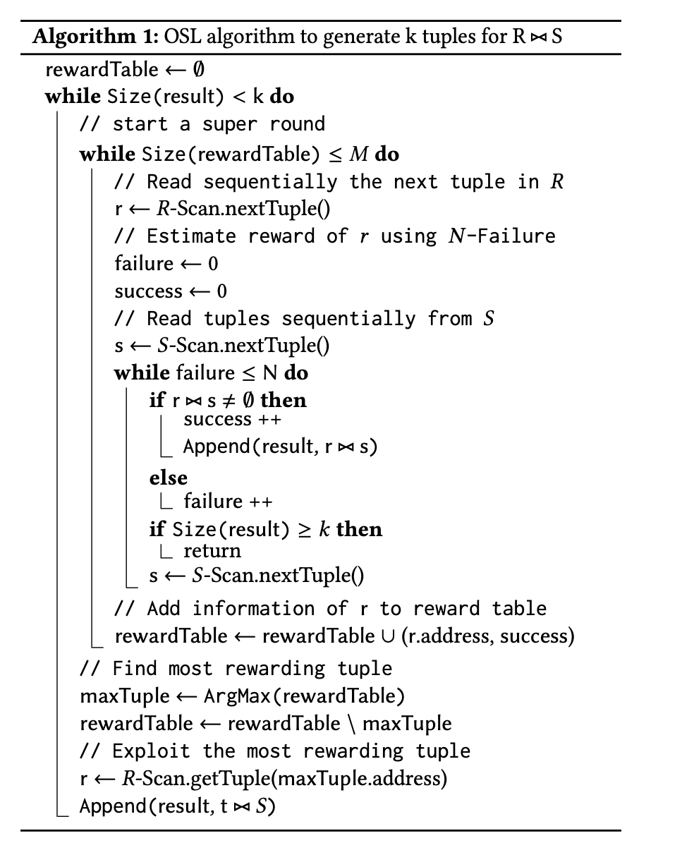
Online Sequetial Learning (OSL)
To speed up the join process for the user who need results in less time and don’t need the fully join result.
Separate to Exploration and exploitation parts.
Exploration part find the tuples in R have higher probability to join with tuples from S.
Exploitation parts join the tuples from exploration with S.
Not able to do fully join due to dropping tuples during exploration part.

Slide 3
Proposal
Extend OSL to do fully join and show it takes almost same time as Block nest loop.
Based on the assumption, we can apply OSL on different Query Scenarios.

Slide 4
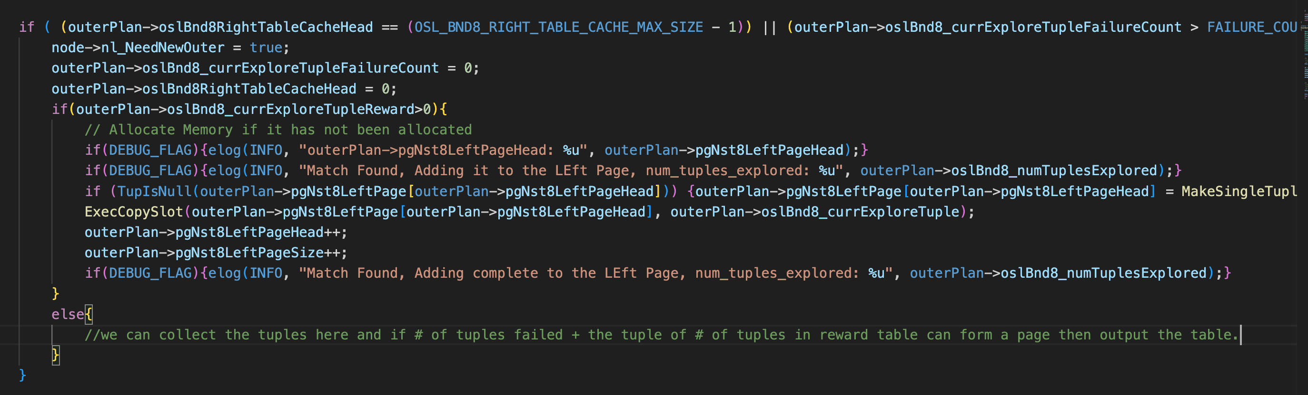
Proposal
To avoid OSL drop the tuples, first we find the code that doing exploration.
Keep the tuples filtered by OSL and join them with S later.

Slide 5
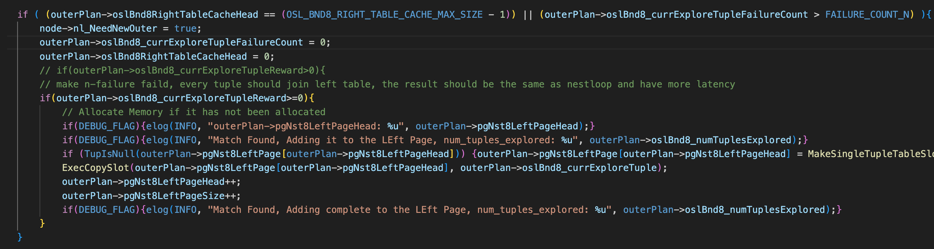
Proposal
Disable the N-failure function in exploration.
Verify the assumption that if we keep the tuples can produce the fully join in OSL.

Slide 6
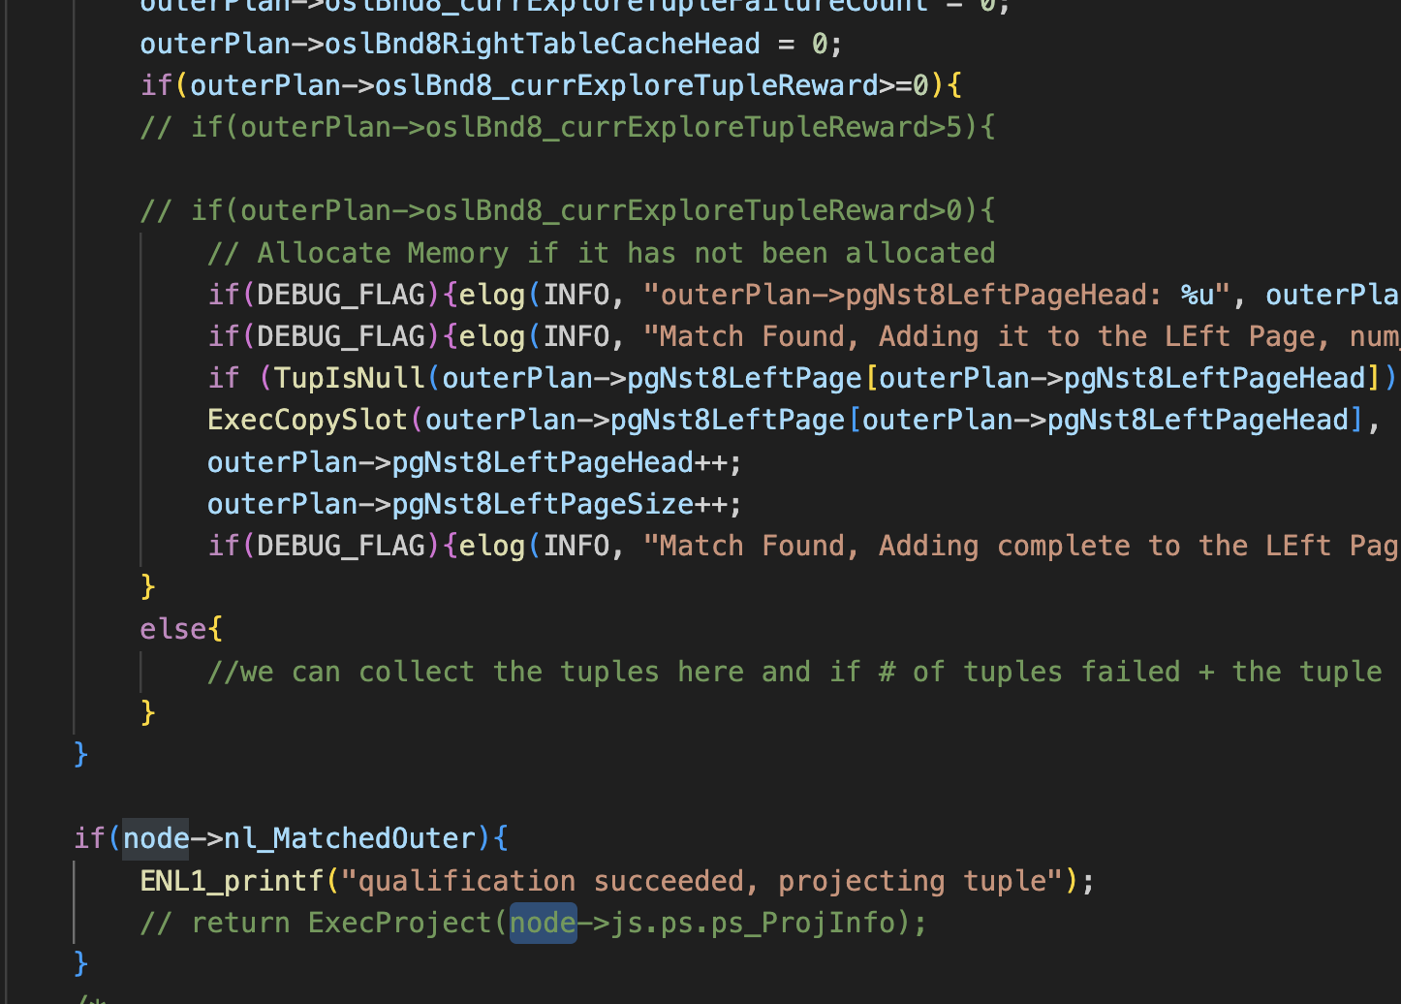
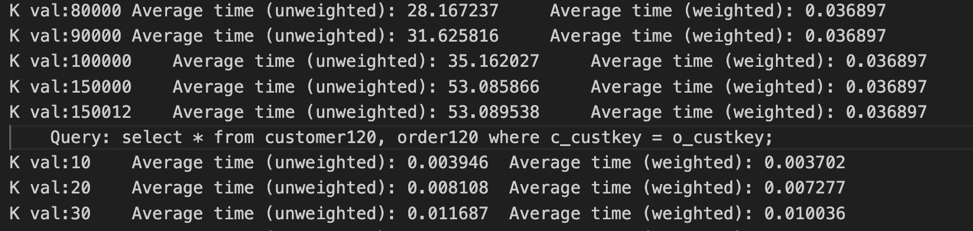
Proposal
Avoid Duplicate results, supposed to be 150000 results

Slide 7
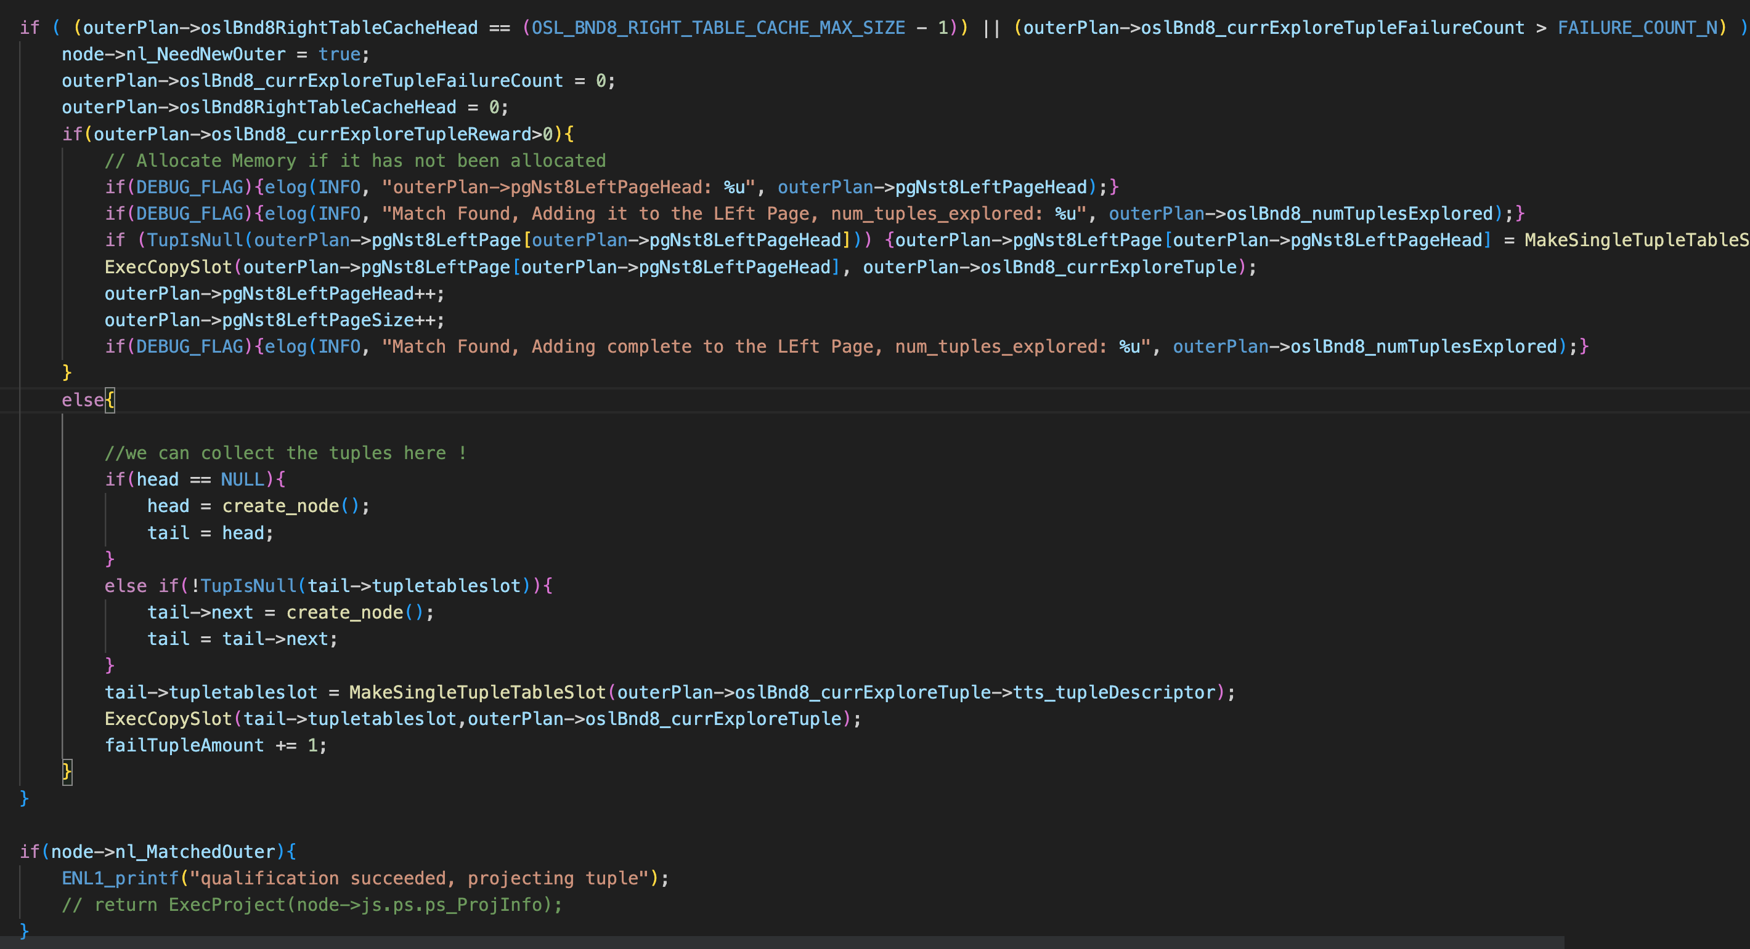
Modification
Create a LinkedList to collect the tuples.

Slide 8
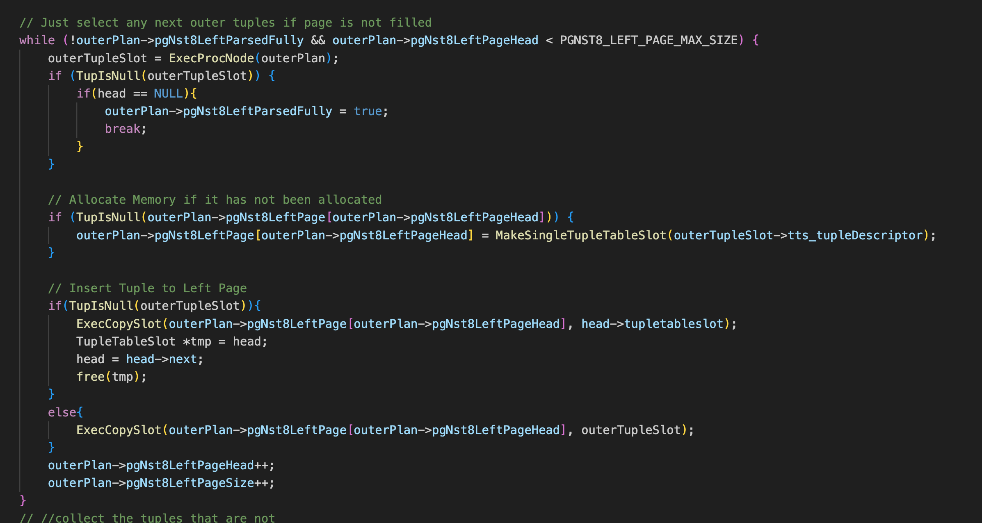
Modification
Insert the collected tuples here.

Slide 9
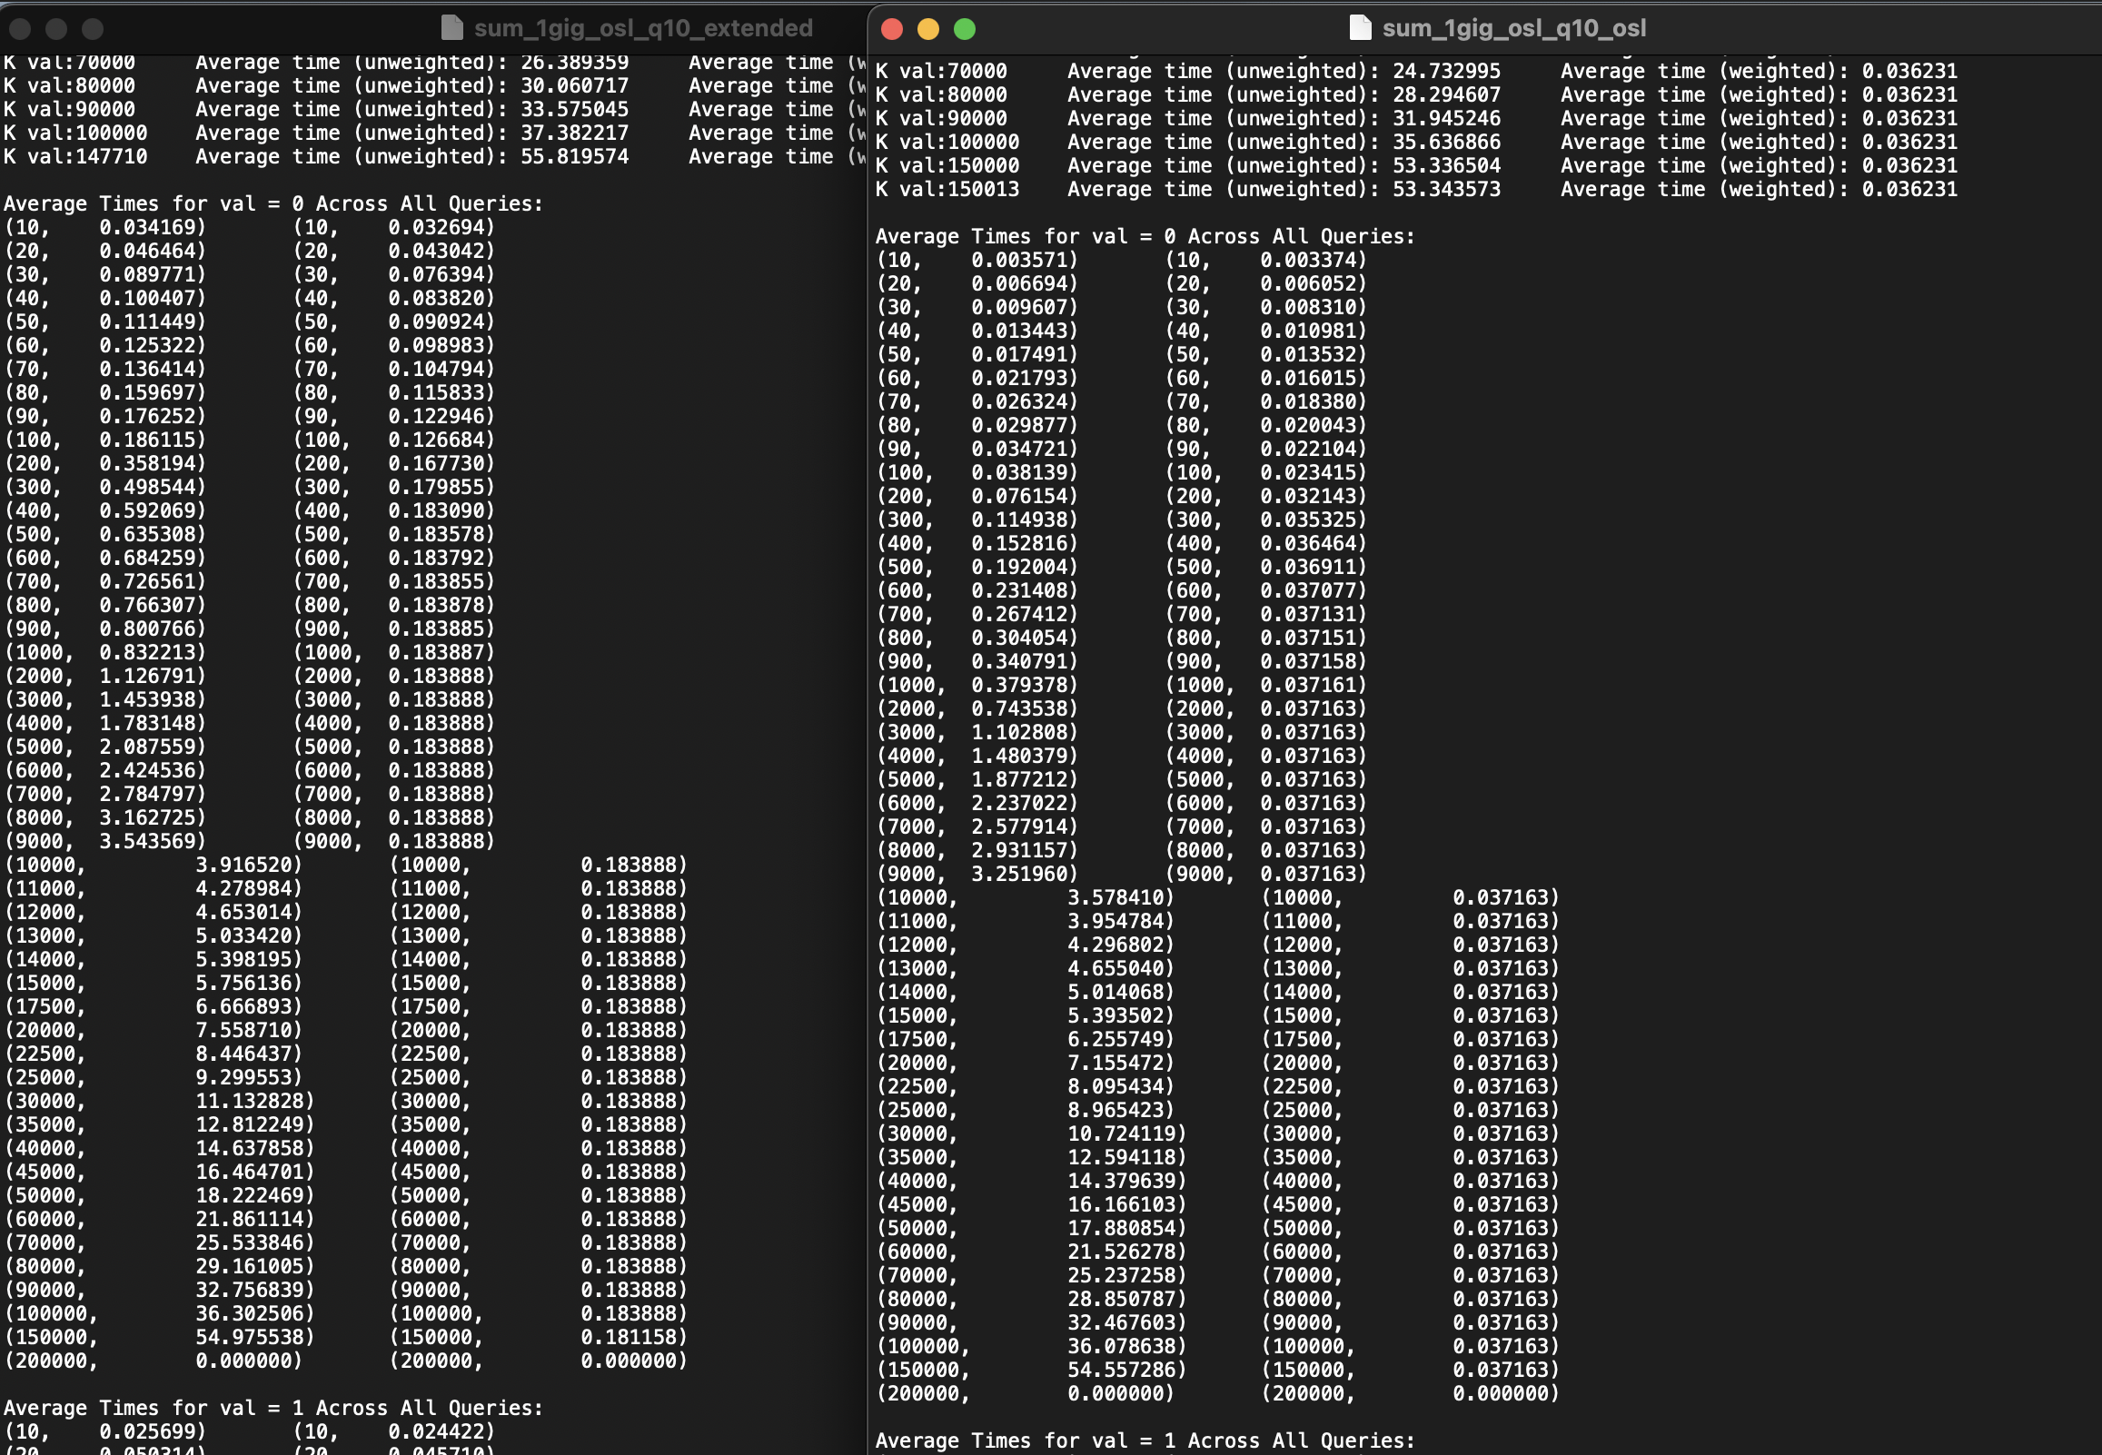
Result
Performance has increase for avg time / join result when compared to OSL without dropping any tuples.

Slide 10
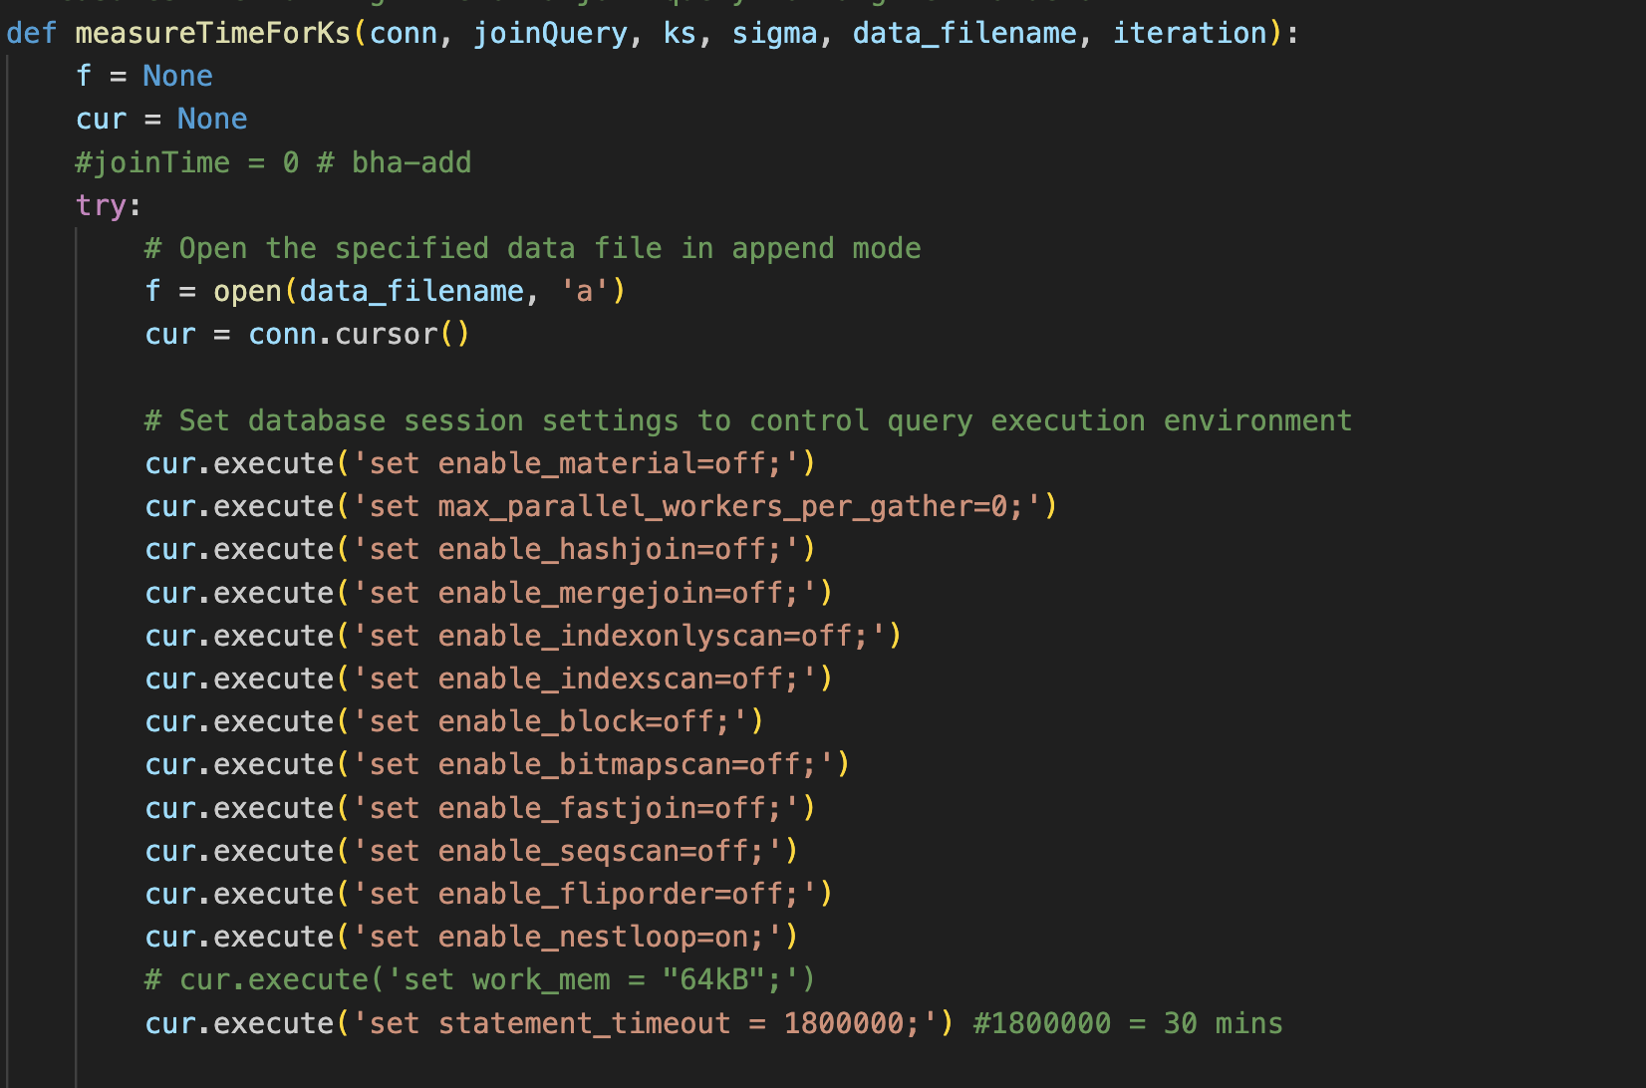
Issue
This method require a lot of memory, might need to optimize the usage of memory.

Slide 11
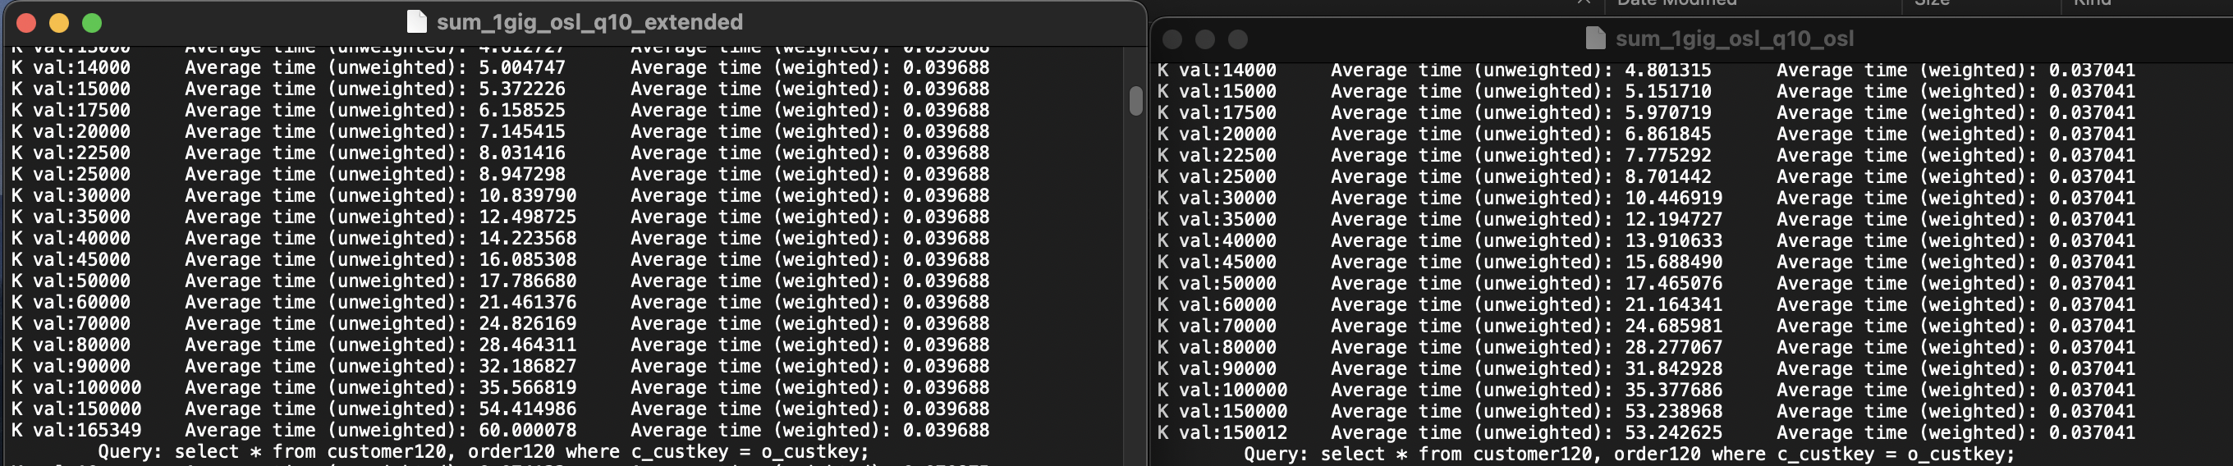
Issue
The amount of results doesn’t match, the proposal code has produced more duplicate results.

